Slide 1
Web Technologies
Application Layer Protocols
By : Arpita Tiwari

Slide 2
Client-Server paradigm
Server
Client
A server is a program running on the remote machine providing service to the clients.
When it starts, it opens the door for incoming requests from clients, but it never initiates a service until it is requested to do so.
A server program is an infinite program. When it starts, it runs infinitely unless a problem arises. It waits for incoming requests from clients.
When a request arrives, it responds to the request, either iteratively or concurrently as we will see shortly.
A client is a program running on the local machine requesting service from a server.
A client program is finite, which means it is started by the user (or another application program) and terminates when the service is complete.
Normally, a client opens the communication channel using the IP address of the remote host and the well-known port address of the specific server program running on that machine.
After a channel of communication is opened, the client sends its request and receives a response. Although the request-response part may be repeated several times, the whole process is finite and eventually comes to an end.

Slide 3

Client-Server Architecture

Slide 4
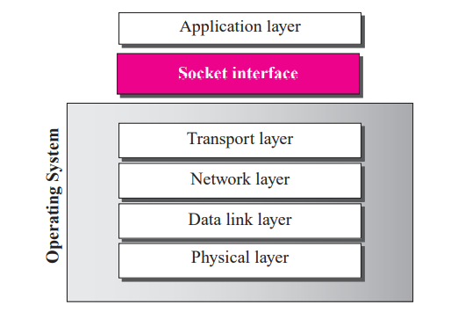
Relation between the operating system and the TCP/IP suite
The socket interface, as a set of instructions, is located between the operating system and the application programs. To access the services provided by the TCP/IP protocol suite, an application needs to use the instructions defined in the socket
interface.

Slide 5
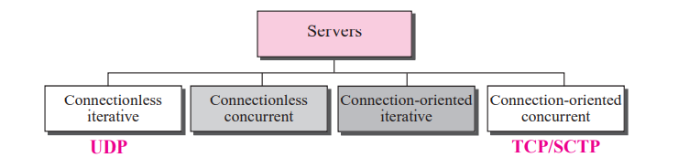
Server types

Slide 6
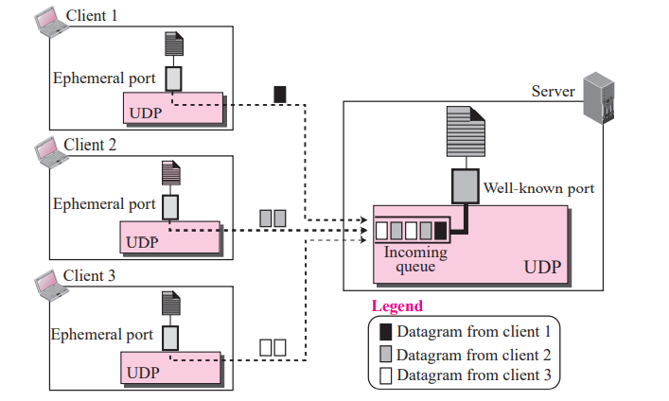
Connectionless iterative server

Slide 7
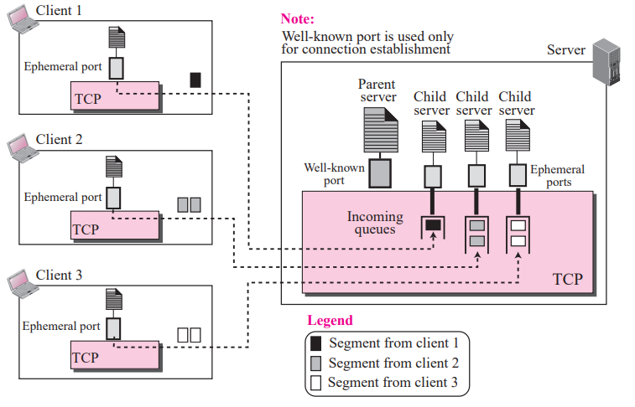
Connection-oriented concurrent server

Slide 8
Domain Name System (DNS)
DNS is a client/server application program used to help other application programs. DNS is used to map a host name in the application layer to an IP address in the network layer.
To identify an entity, TCP/IP protocols use the IP address, which uniquely identifies the connection of a host to the Internet. However, people prefer to use names instead of numeric addresses. Therefore, we need a system that can map a name to an address or an address to a name.

Slide 9
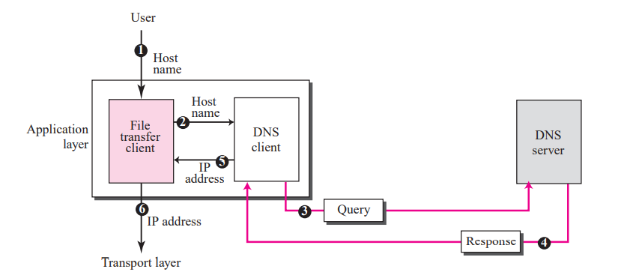

Slide 10
Explanation of given example in previous slide
A user wants to use a file transfer client to access the corresponding file transfer server running on a remote host. The user knows only the file transfer server name, such as forouzan.com. However, the TCP/IP suite needs the IP address of the file transfer server to make the connection. The following six steps map the host name to an IP address.
The user passes the host name to the file transfer client.
The file transfer client passes the host name to the DNS client.
We know that each computer, after being booted, knows the address of one DNS server. The DNS client sends a message to a DNS server with a query that gives the file transfer server name using the known IP address of the DNS server.
The DNS server responds with the IP address of the desired file transfer server.
The DNS client passes the IP address to the file transfer server.
The file transfer client now uses the received IP address to access the file transfer server

Slide 11
Name Space
The names must be unique because the addresses are unique. A name space that maps each address to a unique name can be organized in two ways: flat or hierarchical.
Flat Name Space:
In a flat name space, a name is assigned to an address. A name in this space is a sequence of characters without structure. The names may or may not have a common section; if they do, it has no meaning. The main disadvantage of a flat name space is that it cannot be used in a large system such as the Internet because it must be centrally controlled to avoid ambiguity and duplication.
Hierarchical Name Space:
In a hierarchical name space, each name is made of several parts. The first part can define the nature of the organization, the second part can define the name of an organization, the third part can define departments in the organization, and so on. In this case, the authority to assign and control the name spaces can be decentralized. A central authority can assign the part of the name that defines the nature of the organization and the name of the organization.

Slide 12
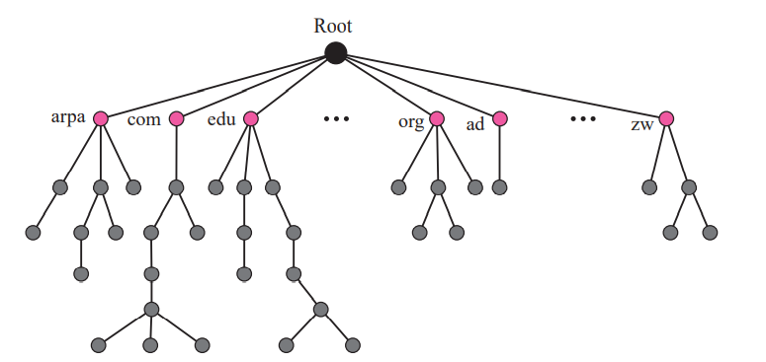
Domain Name Space
To have a hierarchical name space, a domain name space was designed. In this design the names are defined in an inverted-tree structure with the root at the top. The tree can have only 128 levels: level 0 (root) to level 127.

Slide 13
Domain Name Space
Label:
Each node in the tree has a label, which is a string with a maximum of 63 characters. The root label is a null string (empty string). DNS requires that children of a node (nodes that branch from the same node) have different labels, which guarantees the uniqueness of the domain names.

Slide 14
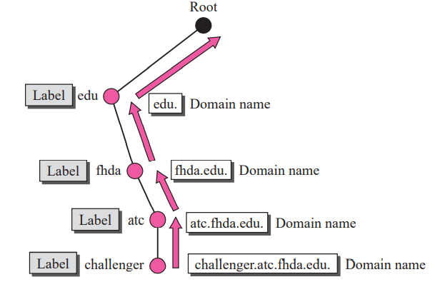
Domain Name Space
Domain Name:
Each node in the tree has a domain name.
A full domain name is a sequence of labels separated by dots (.).
The domain names are always read from the node up to the root. The last label is the label of the root (null).
This means that a full domain name always ends in a null label, which means the last character is a dot because the null string is nothing.

Slide 15
Domain Name Space
Fully Qualified Domain Name (FQDN):
If a label is terminated by a null string, it is called a fully qualified domain name (FQDN). An FQDN is a domain name that contains the full name of a host. It contains all labels, from the most specific to the most general, that uniquely define the name of the host. For example, the domain name is the FQDN of a computer named challenger installed at the Advanced Technology Center (ATC) at De Anza College. A DNS server can only match an FQDN to an address. Note that the name must end with a null label, but because null means nothing, the label ends with a dot (.).

Slide 16
Domain Name Space
Partially Qualified Domain Name (PQDN):
If a label is not terminated by a null string, it is called a partially qualified domain name (PQDN). A PQDN starts from a node, but it does not reach the root. It is used when the name to be resolved belongs to the same site as the client. Here the resolver can supply the missing part, called the suffix, to create an FQDN. For example, if a user at the fhda.edu. site wants to get the IP address of the challenger computer, he or she can define the partial name

Slide 17
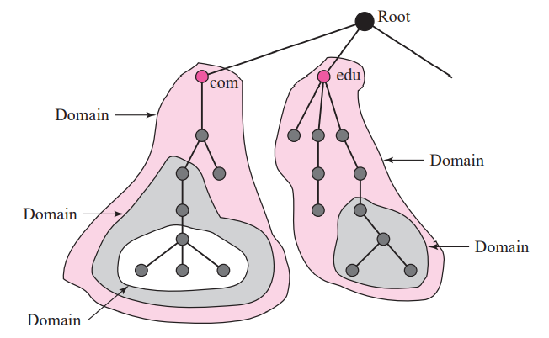
Domain Name Space
Domain:
A domain is a subtree of the domain name space. The name of the domain is the name of the node at the top of the subtree. Figure shows some domains. Note that a domain may itself be divided into domains (or subdomains as they are sometimes called).

Slide 18
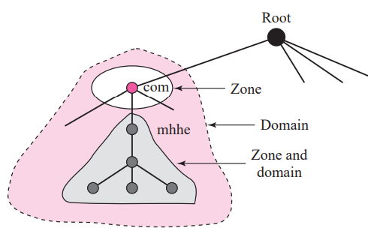
Domain Name Space
Zone:
Since the complete domain name hierarchy cannot be stored on a single server, it is divided among many servers. What a server is responsible for or has authority over is called a zone. We can define a zone as a contiguous part of the entire tree. If a server accepts responsibility for a domain and does not divide the domain into smaller domains, the “domain” and the “zone” refer to the same thing. The server makes a database called a zone file and keeps all the information for every node under that domain. However, if a server divides its domain into subdomains and delegates part of its authority to other servers, “domain” and “zone” refer to different things.

Slide 19
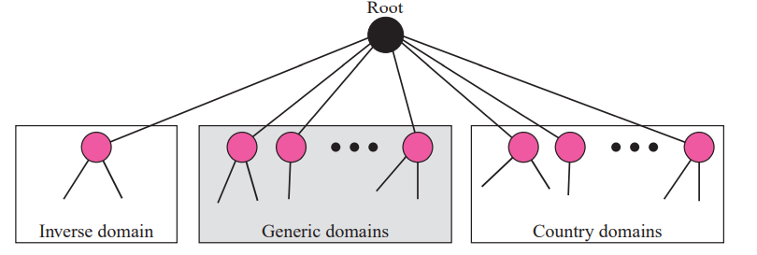
DNS in the Internet
DNS is a protocol that can be used in different platforms. In the Internet, the domain name space (tree) is divided into three different sections: generic domains, country domains, and the inverse domain

Slide 20
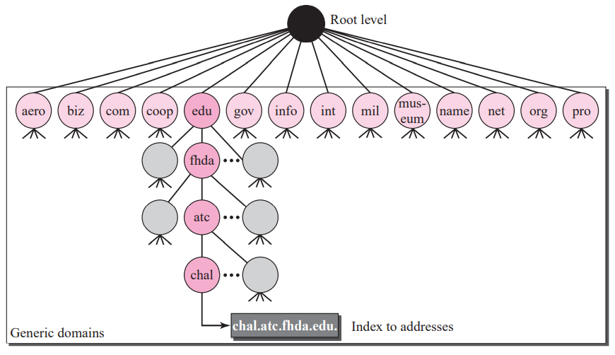
Generic Domains
The generic domains define registered hosts according to their generic behavior. Each node in the tree defines a domain, which is an index to the domain name space database. 14 possible labels.

Slide 21
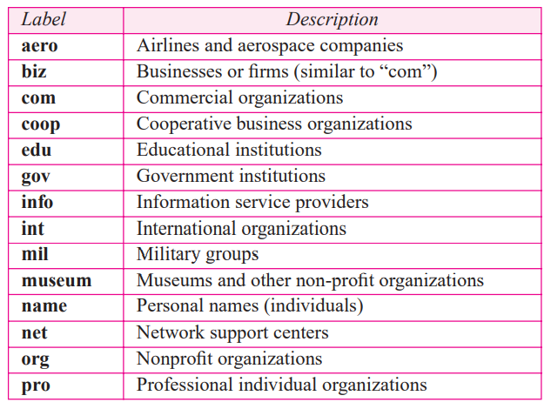
Generic domain labels

Slide 22
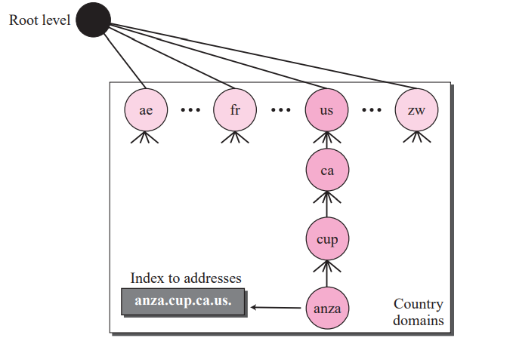
Country Domains
The country domains section uses two-character country abbreviations (e.g., us for United States). Second labels can be organizational, or they can be more specific, national designations. The United States, for example, uses state abbreviations as a subdivision of us (e.g., ca.us.).
The address anza.cup.ca.us can be translated to De Anza College in Cupertino in California in the United States.

Slide 23
World Wide Web
World Wide Web, which is also known as a Web, is a collection of websites or web pages stored in web servers and connected to local computers through the internet.
These websites contain text pages, digital images, audios, videos, etc. Users can access the content of these sites from any part of the world over the internet using their devices such as computers, laptops, cell phones, etc.
The WWW, along with internet, enables the retrieval and display of text and media to your device.

Slide 24
World Wide Web
The building blocks of the Web are web pages which are formatted in HTML and connected by links called "hypertext" or hyperlinks and accessed by HTTP. These links are electronic connections that link related pieces of information so that users can access the desired information quickly. Hypertext offers the advantage to select a word or phrase from text and thus to access other pages that provide additional information related to that word or phrase.
A web page is given an online address called a Uniform Resource Locator (URL). A particular collection of web pages that belong to a specific URL is called a website, e.g., www.facebook.com, www.google.com, etc. So, the World Wide Web is like a huge electronic book whose pages are stored on multiple servers across the world.
Small websites store all of their WebPages on a single server, but big websites or organizations place their WebPages on different servers in different countries so that when users of a country search their site they could get the information quickly from the nearest server.

Slide 25
Difference between World Wide Web and Internet:
Internet/internet
WWW
Some people use the terms 'internet' and 'World Wide Web' interchangeably.
They think they are the same thing, but it is not so.
Internet is entirely different from WWW.
It is a worldwide network of devices like computers, laptops, tablets, etc. It enables users to send emails to other users and chat with them online.
For example, when you send an email or chatting with someone online, you are using the internet.
But, when you have opened a website like google.com for information, you are using the World Wide Web; a network of servers over the internet.
You request a webpage from your computer using a browser, and the server renders that page to your browser.
Your computer is called a client who runs a program (web browser), and asks the other computer (server) for the information it needs.

Slide 26
History of the World Wide Web:
The World Wide Web was invented by a British scientist, Tim Berners-Lee in 1989. He was working at CERN at that time. Originally, it was developed by him to fulfill the need of automated information sharing between scientists across the world, so that they could easily share the data and results of their experiments and studies with each other.
CERN, where Tim Berners worked, is a community of more than 1700 scientists from more than 100 countries. These scientists spend some time on CERN site, and rest of the time they work at their universities and national laboratories in their home countries, so there was a need for reliable communication tools so that they can exchange information.

Slide 27
History of the World Wide Web:
Internet and Hypertext were available at this time, but no one thought how to use the internet to link or share one document to another. Tim focused on three main technologies that could make computers understand each other, HTML, URL, and HTTP. So, the objective behind the invention of WWW was to combine recent computer technologies, data networks, and hypertext into a user-friendly and effective global information system.

Slide 28
Thank You

